Slide 1
Kings of Dominia
Alexander Schuster, Mengdi Wang ,
Mohamed Haddej, Alexander Epple

Slide 2

Trailer

Slide 3
Game Overview
Titel: Kings of Dominia
Platform: Android/iOS & Windows
Genre: Puzzle / Strategy
Rating: FSK 0
Target: Casual Gamer

Slide 4

High Concept& Unique Selling Points
Publisher:
Cheap to expand if successful (DLCs)
Player:
Unique game and concept
Cross platform (more options)
Almost no acquisition cost
Cross plattform (bigger market)
Better graphics than comparable games

Slide 5
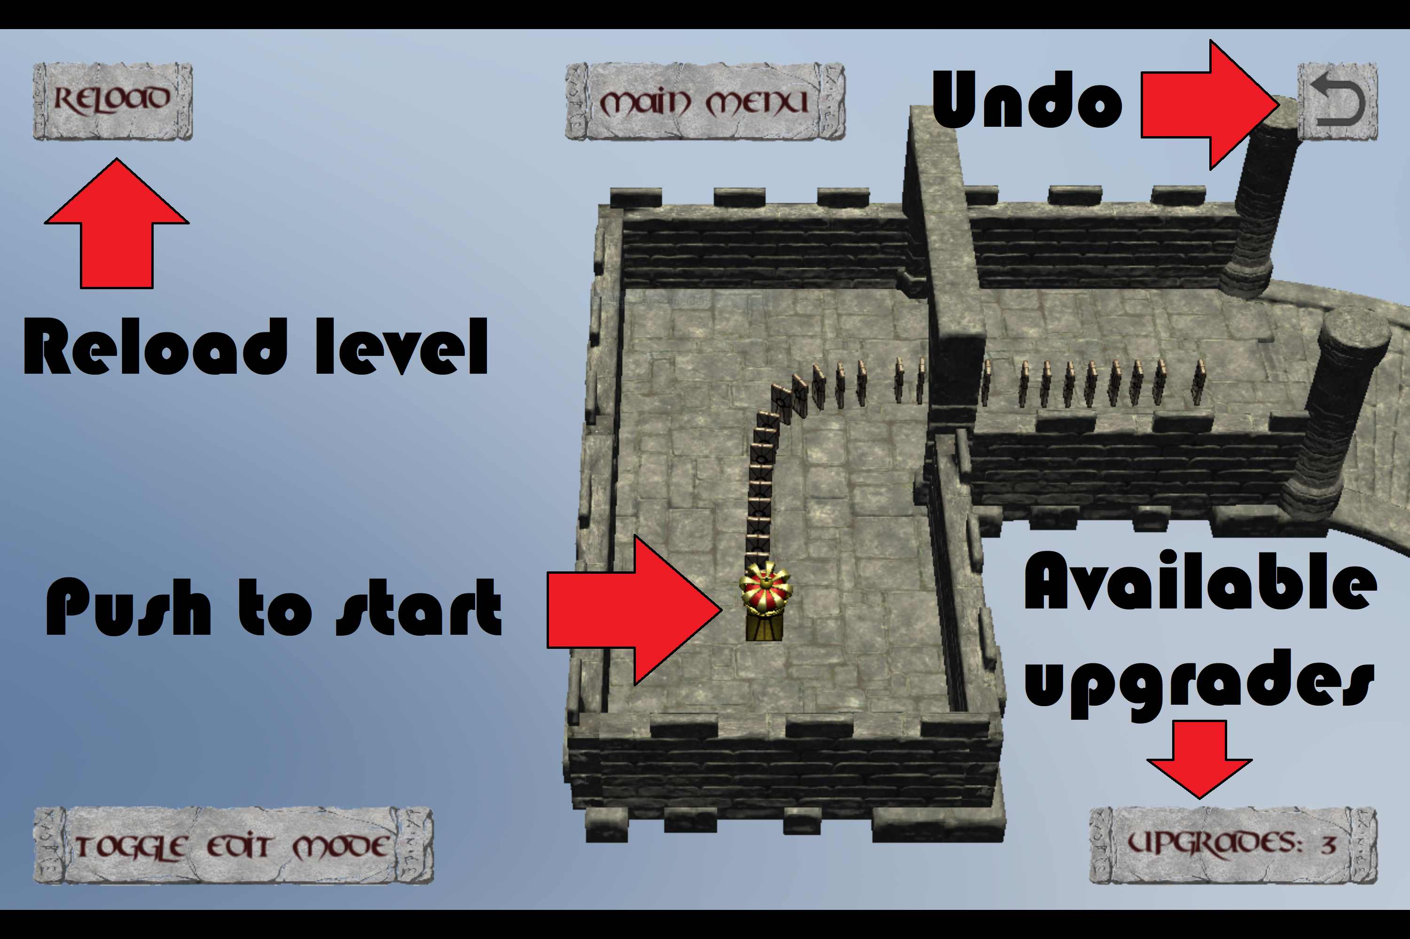
Game Overview

Slide 6
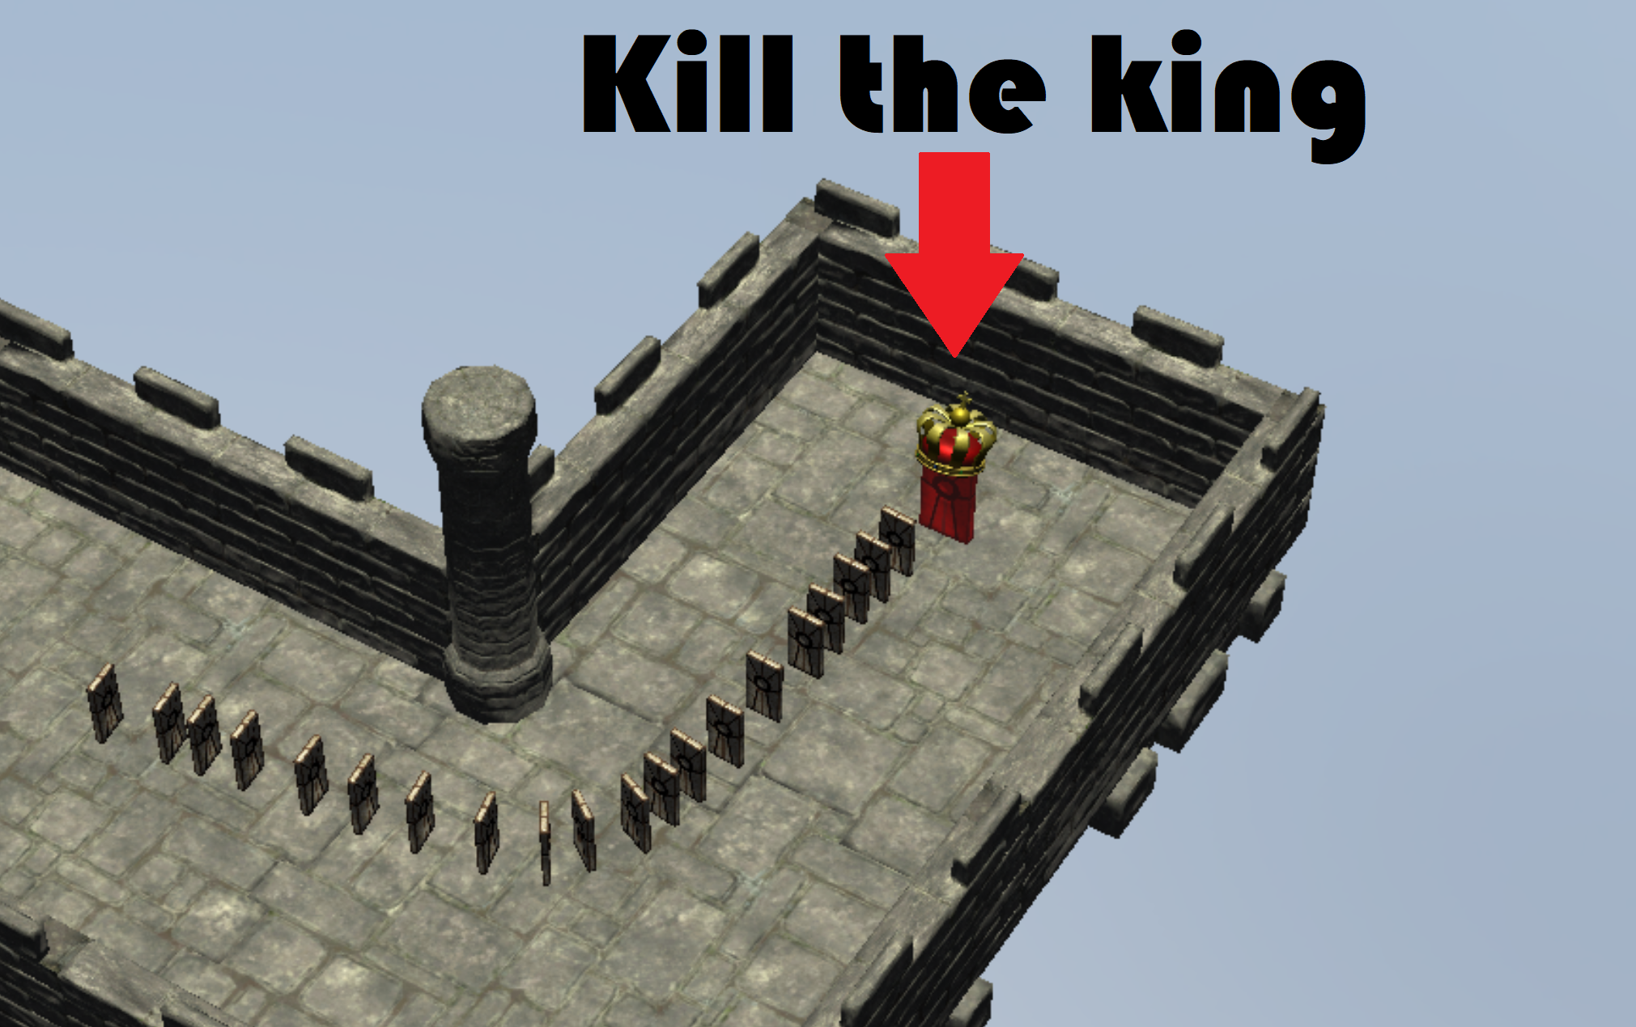
Game Overview

Slide 7
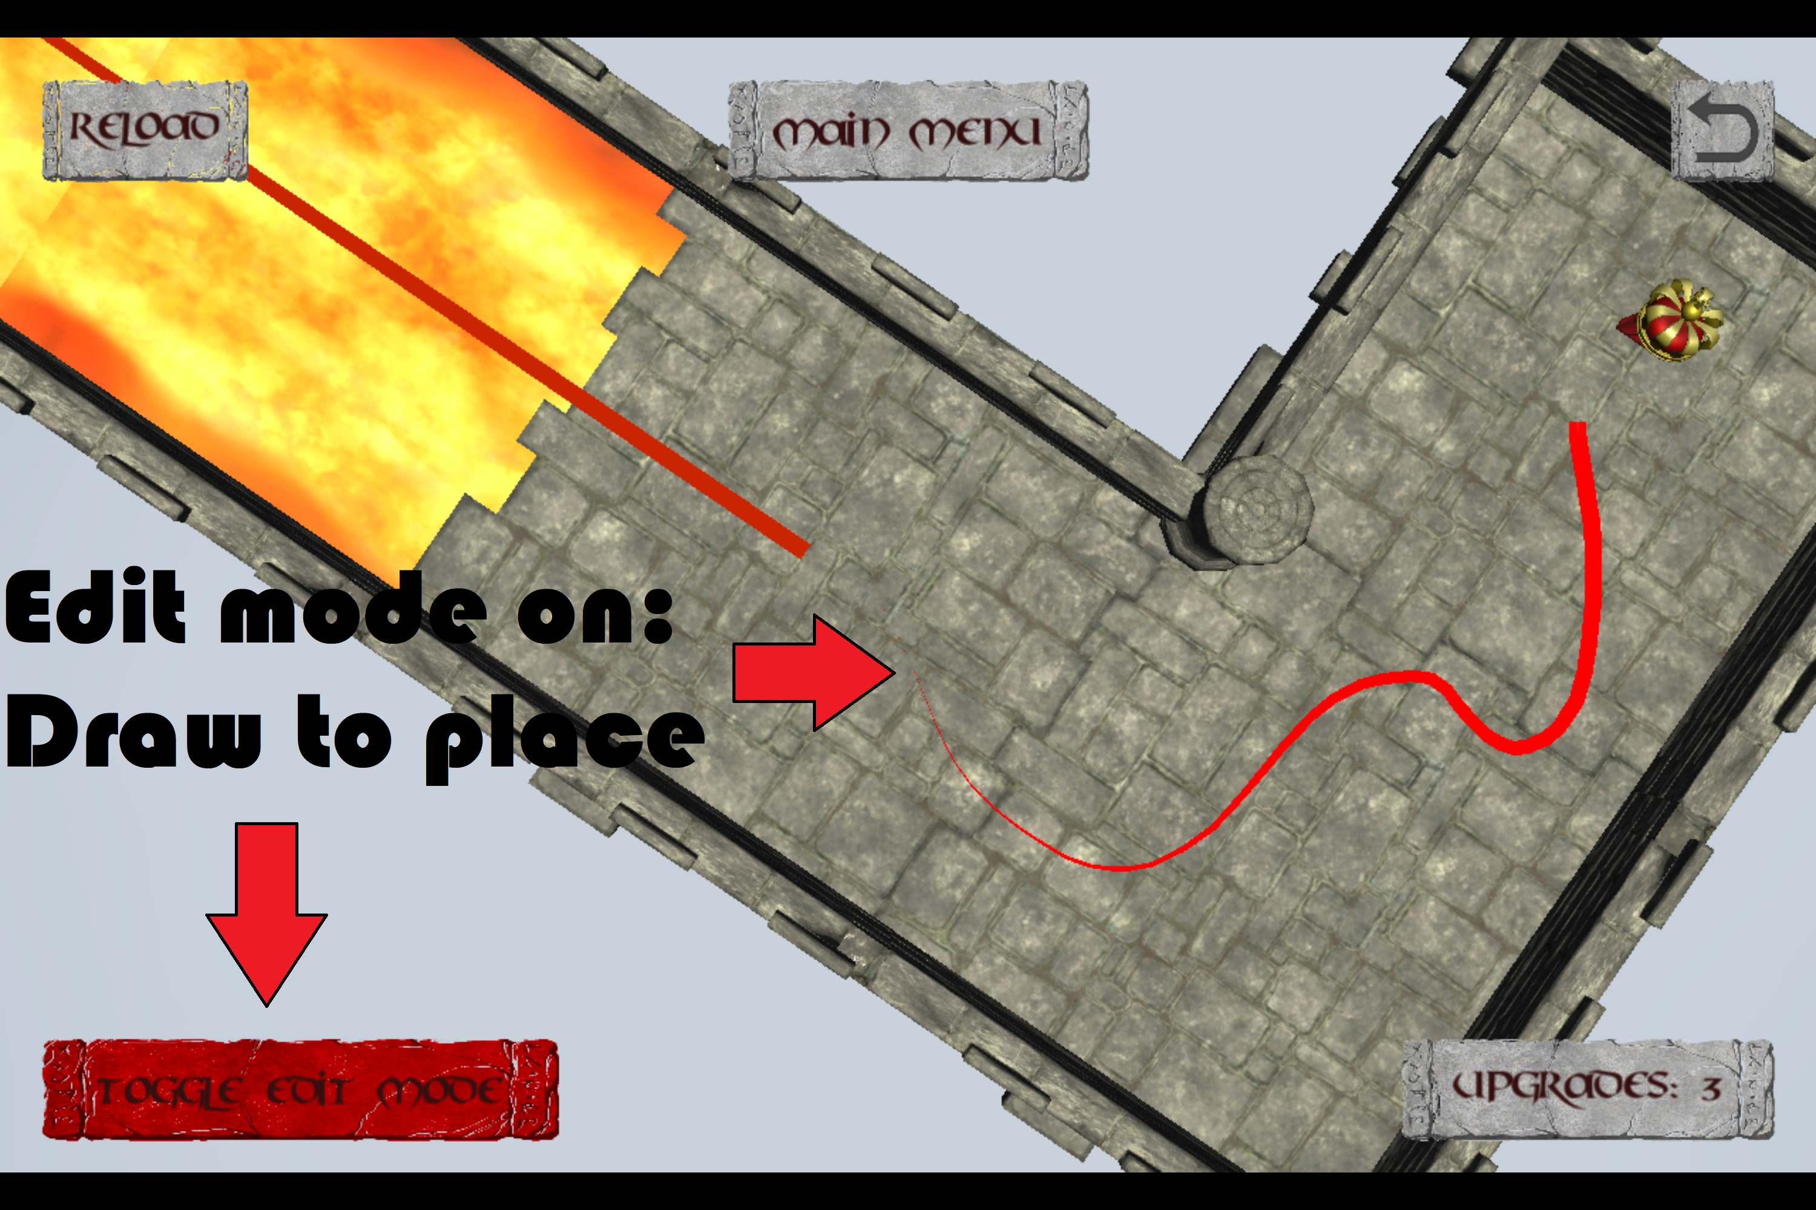
Game Overview

Slide 8
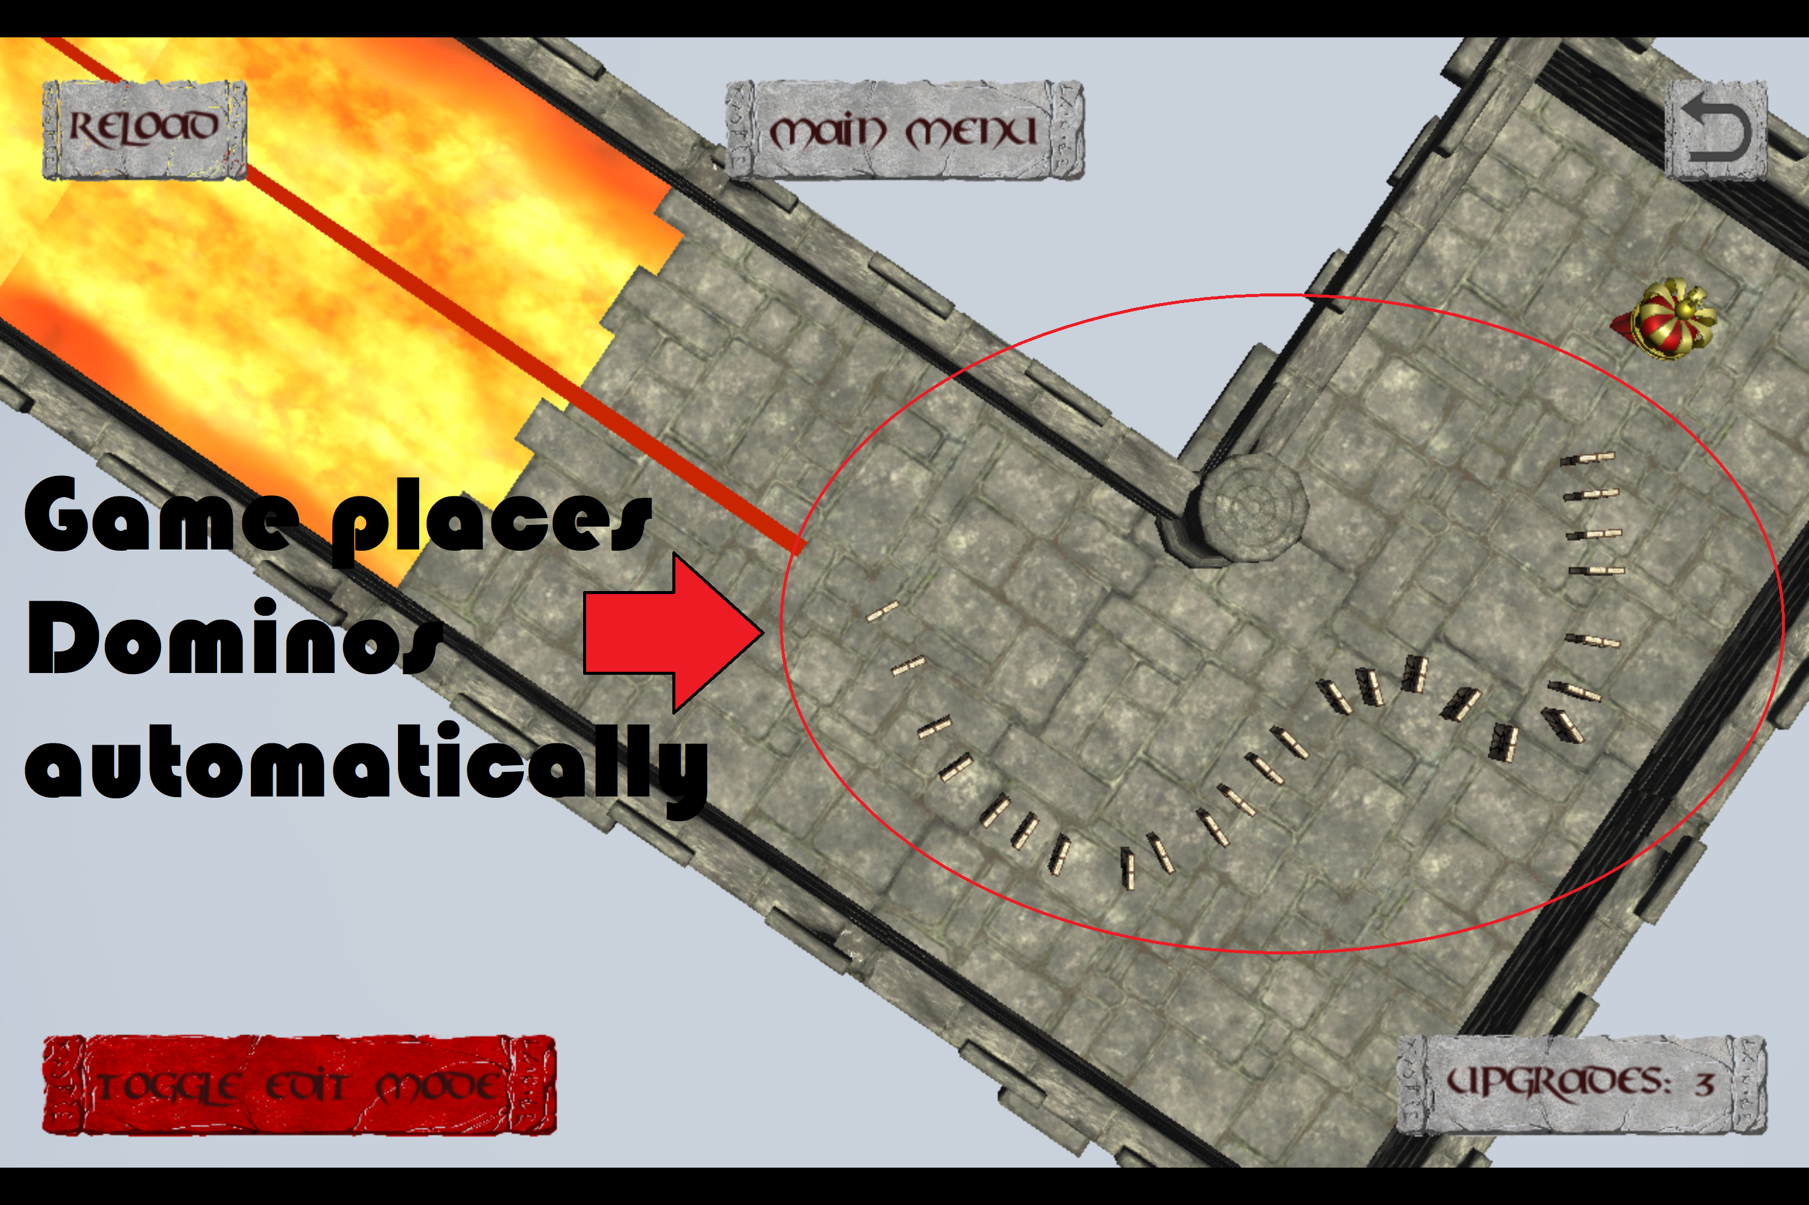
Game Overview

Slide 9
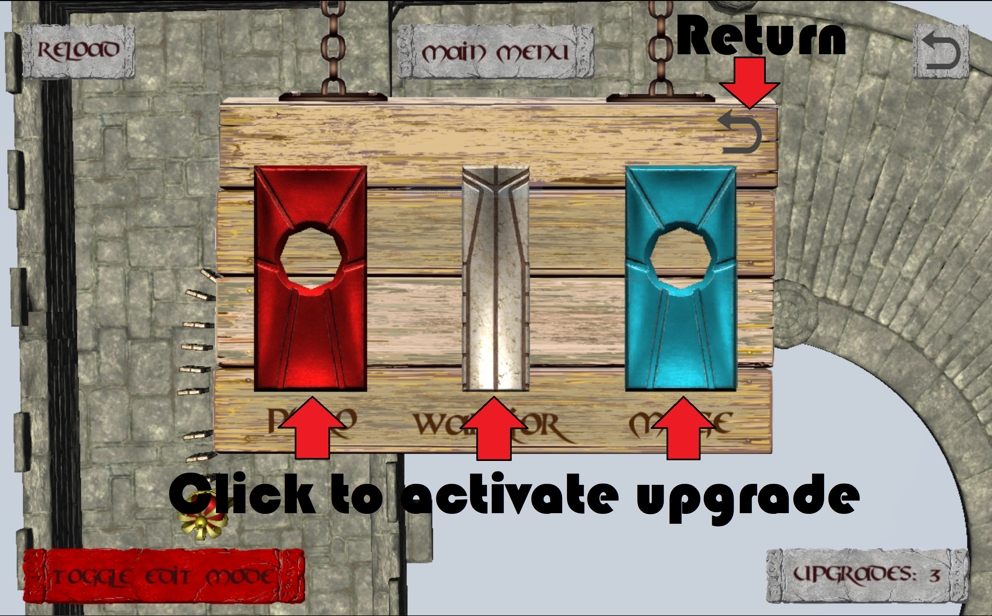
Game Overview

Slide 10
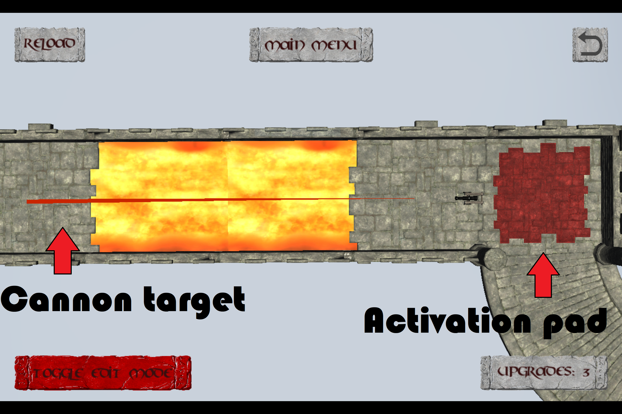
Game Overview

Slide 11
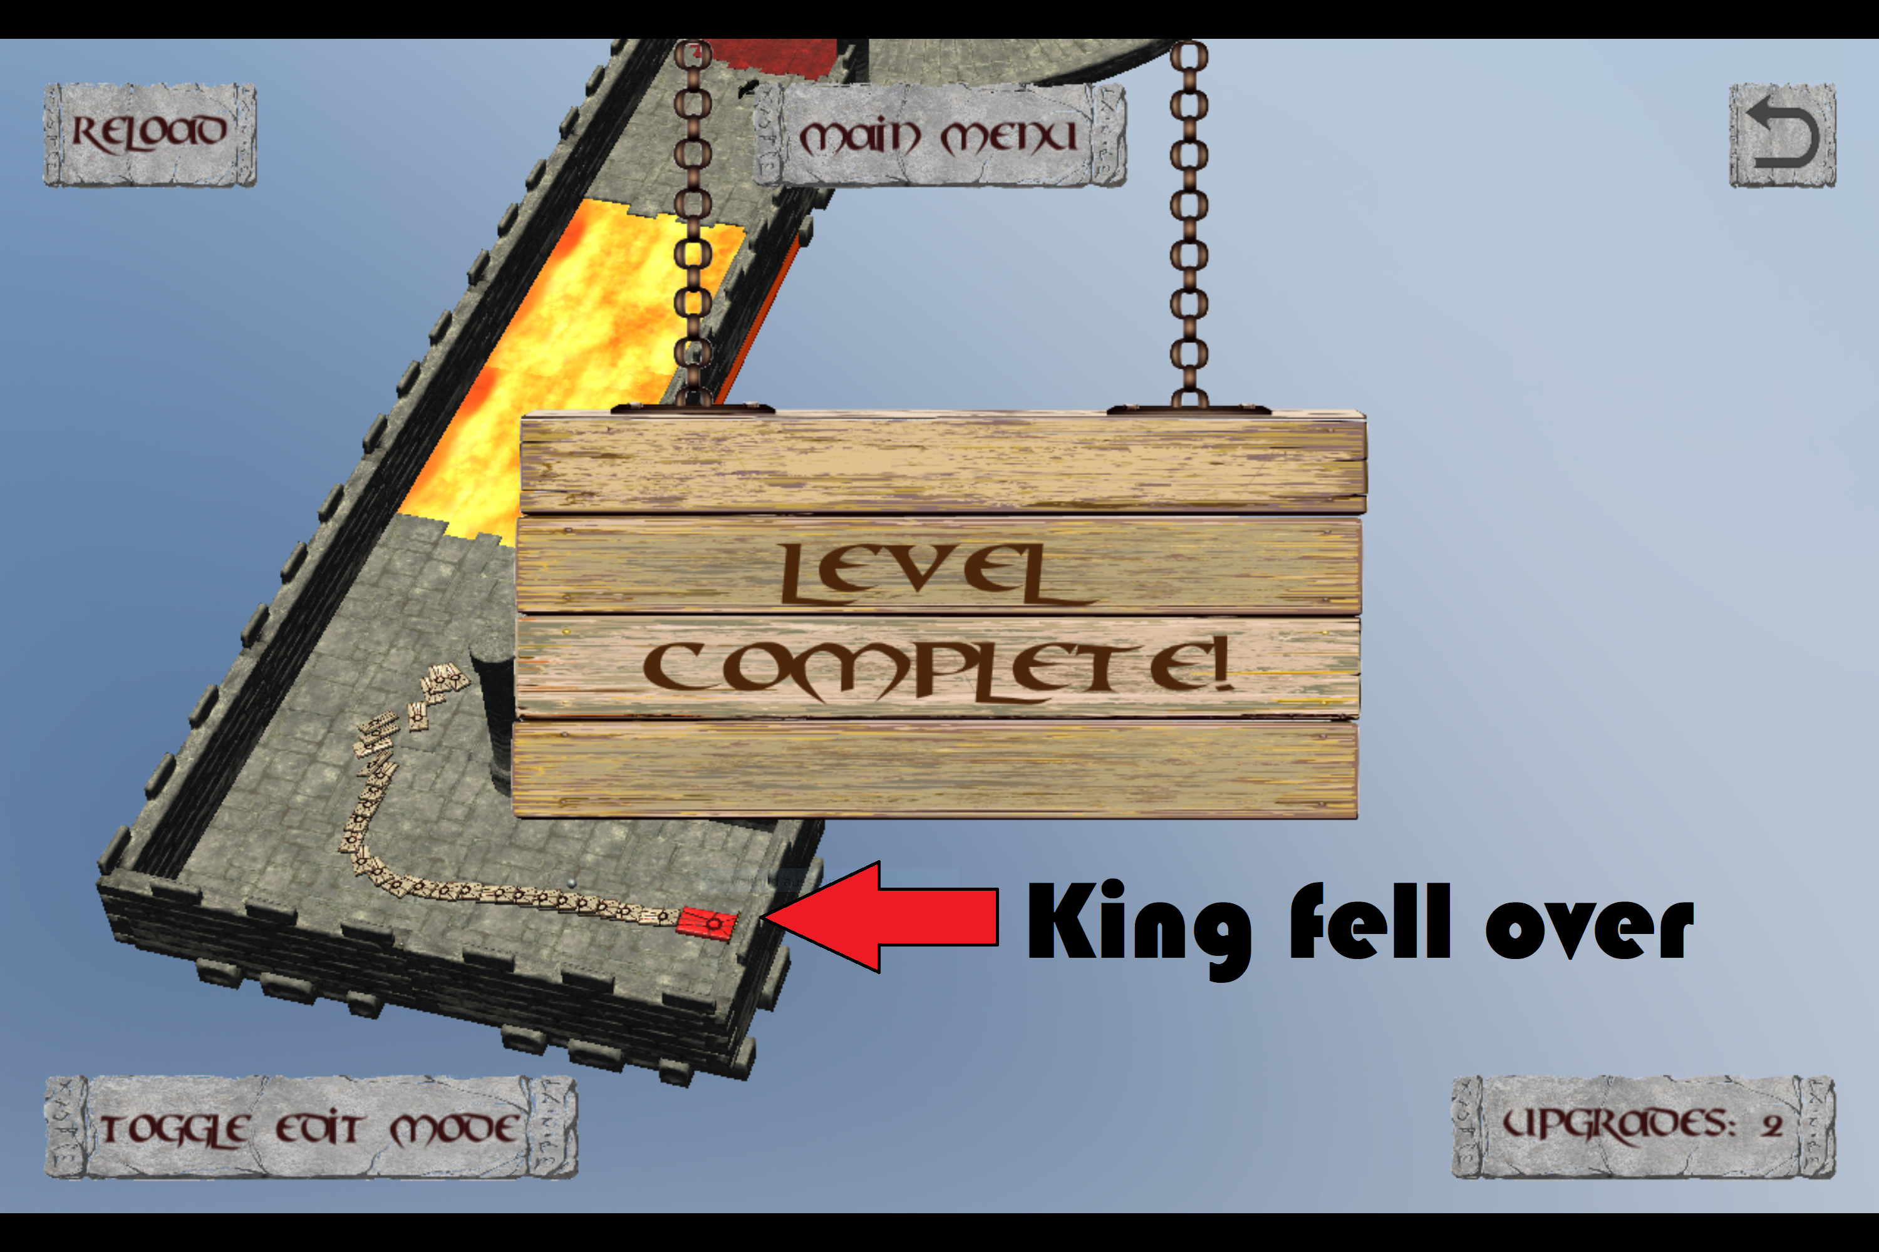
Game Overview

Slide 12


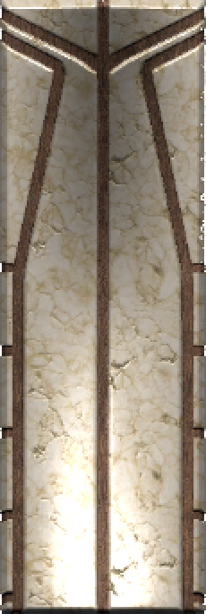
Stone Upgrades
Ice Mage
Pyro
Warrior

Slide 13
Project Plan Part 1: Work Division
 | Prototype | Presentation & Pitch
Alex E | Programming, Debugging | Game design, Story, Trailer
Alex S | Art Modelling | Cost, Break-Even, Marketing, Pricing
Mengdi | Programming, Debugging | Project Plan, Publishing, Trailer
Taieb | Sound Effect

Slide 14
Project Plan Part 2: Platform & Tools
Communication
Face-To-Face
Whatsapp
Discord
Prototype Platform
Unity
Source Control
Github

Slide 15

Project Plan Part 3: Time Estimation
Before our project starts…
 | Estimated Time | Deadline
Idea & Concept | 3 weeks | 20.11.2017 (4th Seminar)
Game Mechanic | 1 week | 27.11.2017 (5th Seminar)
First playable Level | 4 weeks | 24.12.2017 (Chrismas)
All Models added |  | 24.01.2018
All Sound Effect added |  | 24.01.2018
UI finished | 2 weeks | 24.01.2018
All Levels finished | 4 weeks | 25.01.2018
Game Build successful | 1 day | 26.01.2018

Slide 16

Project Plan Part 3: Time Estimation
When it really starts…
 | Finished Time | Overdue?
Idea & Concept | 27.11.2017 | Yes ☹
Game Mechanic | 28.11.2017 | Yes ☹
First playable Level | 05.12.2017 | No ☺
All Models added | 21.12.2017 | No ☺
All Sound Effect added | 22.01.2018 | No ☺
UI finished | 15.01.2018 | No ☺
All Levels finished | 21.01.2018 | No ☺
Game Build successful | 24.01.2018 | No ☺☺☺

Slide 17
Project Plan Part 4: Action List (real)
Action | Date | Notes
1. Team Set Up | 23.10.2017 | 1st Seminar
2. New Member | 06.11.2017 | 2nd Seminar
3. Kick-Off 1 | 27.11.2017 | Game Idea confirmed
4. Level Design | 16.01.2018 | Two more Level Designs
5. Trailer | 25.01.2018 | Trailer finished
6. Presentation | 06.03.2018 | Presentation finished

Slide 18
Project Plan Part 5: Milestones (real)
Milestones | Date | Notes
1. Kick-Off 2 | 28.11.2017 | Game mechanic confirmed
2. First Commit | 03.12.2017
3. New Models | 04.12.2017
4. First Test Level | 05.12.2017 | First playable Level
5. Domino Spawn | 07.12.2017 | Drag spawns Domino
6. Edit Mode | 15.12.2017
7. Line Renderer | 15.12.2017 | Spawn shows line
8. Camera Function | 17.12.2017
9. New Domino Type | 18.12.2017 | Ice Domino added

Slide 19
Project Plan Part 5: Milestones (real)
Milestones | Date | Notes
10. Reverse Mechanic | 18.12.2017 | Game Reverse Framework
11. Basic UI | 19.12.2017 | Primary UI added
12. Sound Effect | 21.12.2017
13. UI Refinement | 15.01.2018 | UI finished
14. New Domino Type | 17.01.2018 | Pyro Domino added
15. New Levels | 21.01.2018 | New Designs realized
16. Model Refinement | 22.01.2018 | All Models finished
17. Vibration | 24.01.2018 | Vibration added
18. Project Build | 24.01.2018 | Prototype finished! ☺

Slide 20
Project Plan Part 6: Future
Since our prototype is already finished,
what if we were to start as a real indie team right now?
Team Reinforcement ?
No need ☺
2 Programmers
1 Audio Engineer
1 Art Designer
Nice-To-Have: Assistant for Marketing & Publishing

Slide 21
Project Plan Part 6: Future
Imaginary Time Estimation (most likely)
 | Estimated Time
New Game Concept & Story | 1 week / maybe not
Game Mechanic Refinement | 2 weeks
Target Group Analysis | 1 week
First Test Level | 2 weeks
Game Design Refinement | Consecutive
First playable Beta Level | 4 weeks
All Levels playable | 4 weeks
Level Beatufication | 2 weeks
Total | 3.5 Months

Slide 22




Publishing & Sales Platform
Since it is a game focusing on mobile touchscreen device…
No special need for Publisher
But high demand to Sales Platform…
70% / 30%
+ 100 $
70% / 30%
???
(70% / 30%)
70% / 30%

Slide 23




Financing
We hope we can get financing from…
Crowdfunding
Support Program
Private Investor
Someone else?

Slide 24
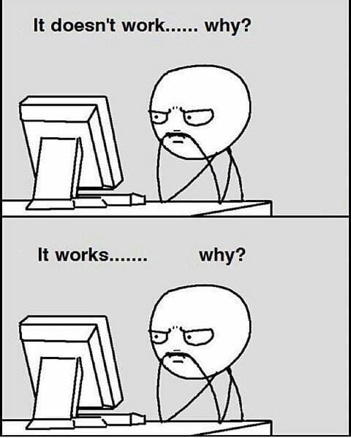
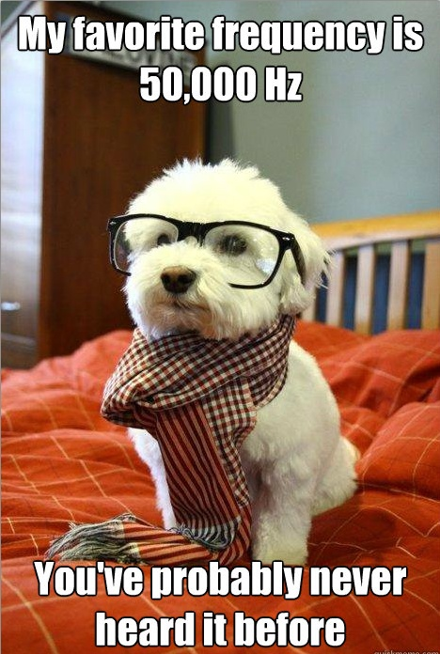
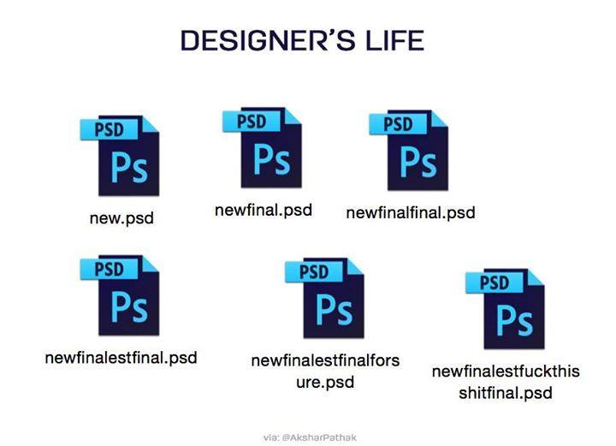
Costs
Fixed Cost Estimate
[1]
[2]
[3]
2x Programmer
1x Audio Engineer
1x Art Designer
Salary between 2900$ – 4000$. We take: 3.500$ x 4 = 14.000$ per month
Unity Plus: 35$ x 4 = 140$ per month

Slide 25
Costs
Jump Fixed Costs / Variable Costs
Synchronously speaker for story
External studio for skins and extra levels
Mac workstation
Apple developer account
Nice-To-Have

Slide 26
Costs
Time Assessment
Best Case | 2 Months
Most Likely | 3,5 Months
Worst Case | 6 Months
Time cost estimation: 1/6 x (2x2 + 3x6 + 3,5) = 4,25 months
Total fixed costs: 4,25 x 14.140$ = 60.095$

Slide 27

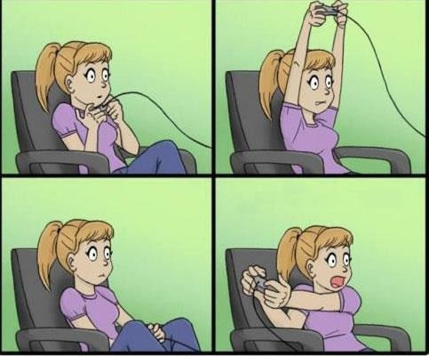
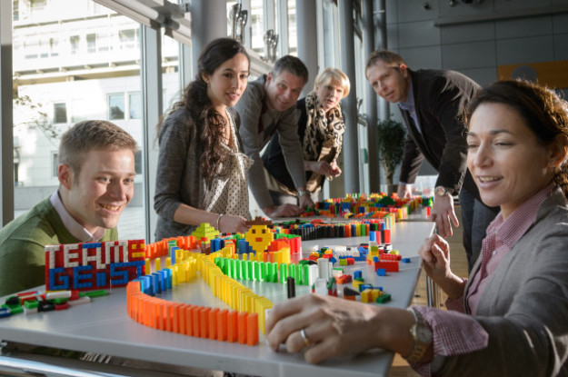
Marketing
Target Group
casual gamers
[4]
puzzle solvers
[5]
domino enthusiasts
[6]
Challenge: appeal to both target groups

Slide 28
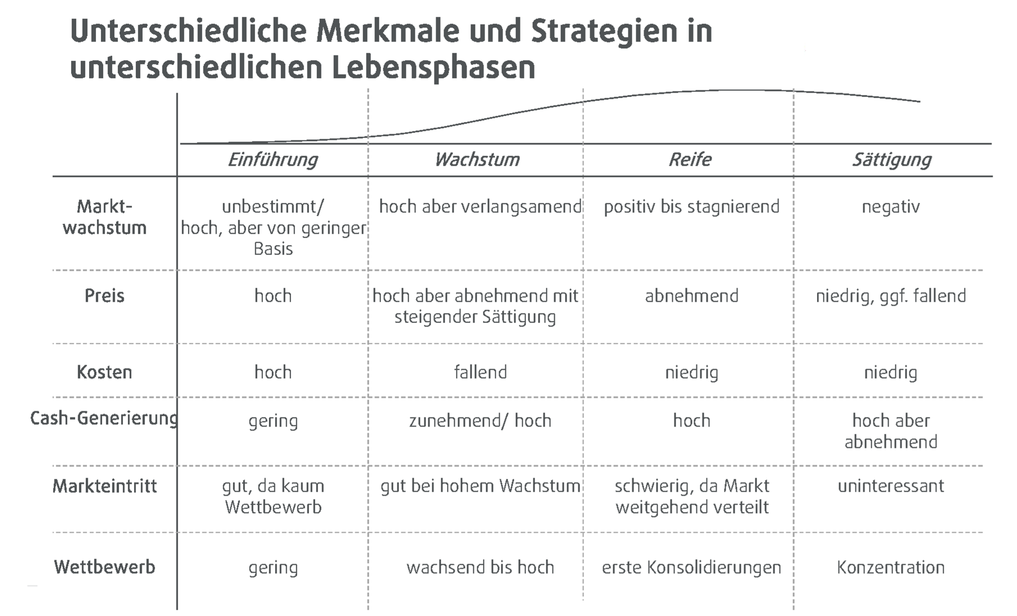
Marketing

Slide 29
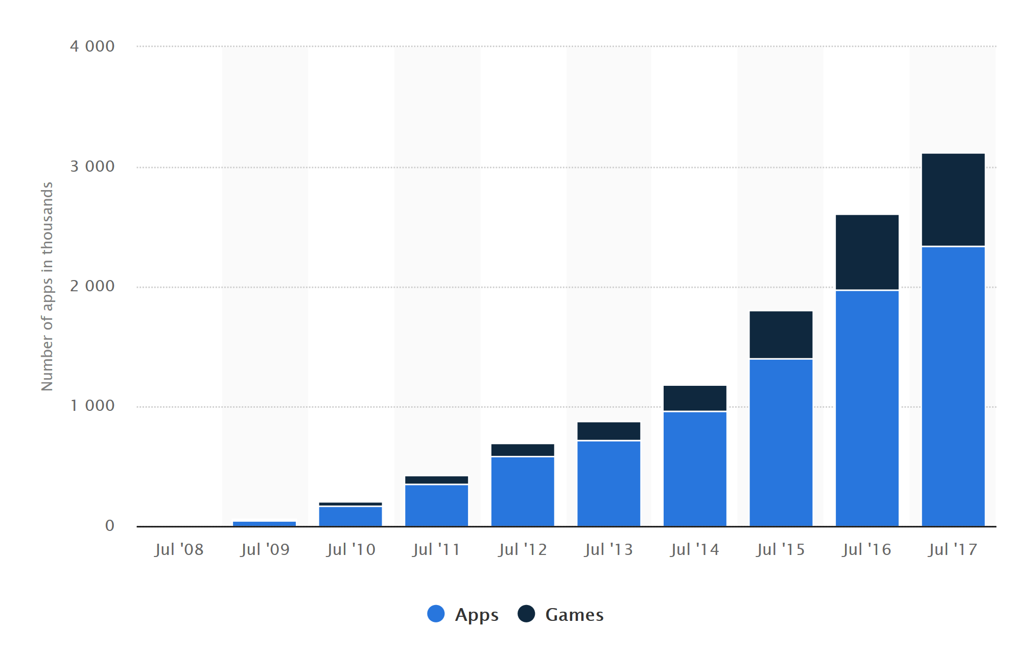
Marketing
Apple Appstore
[7]

Slide 30
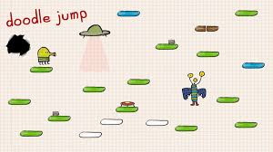
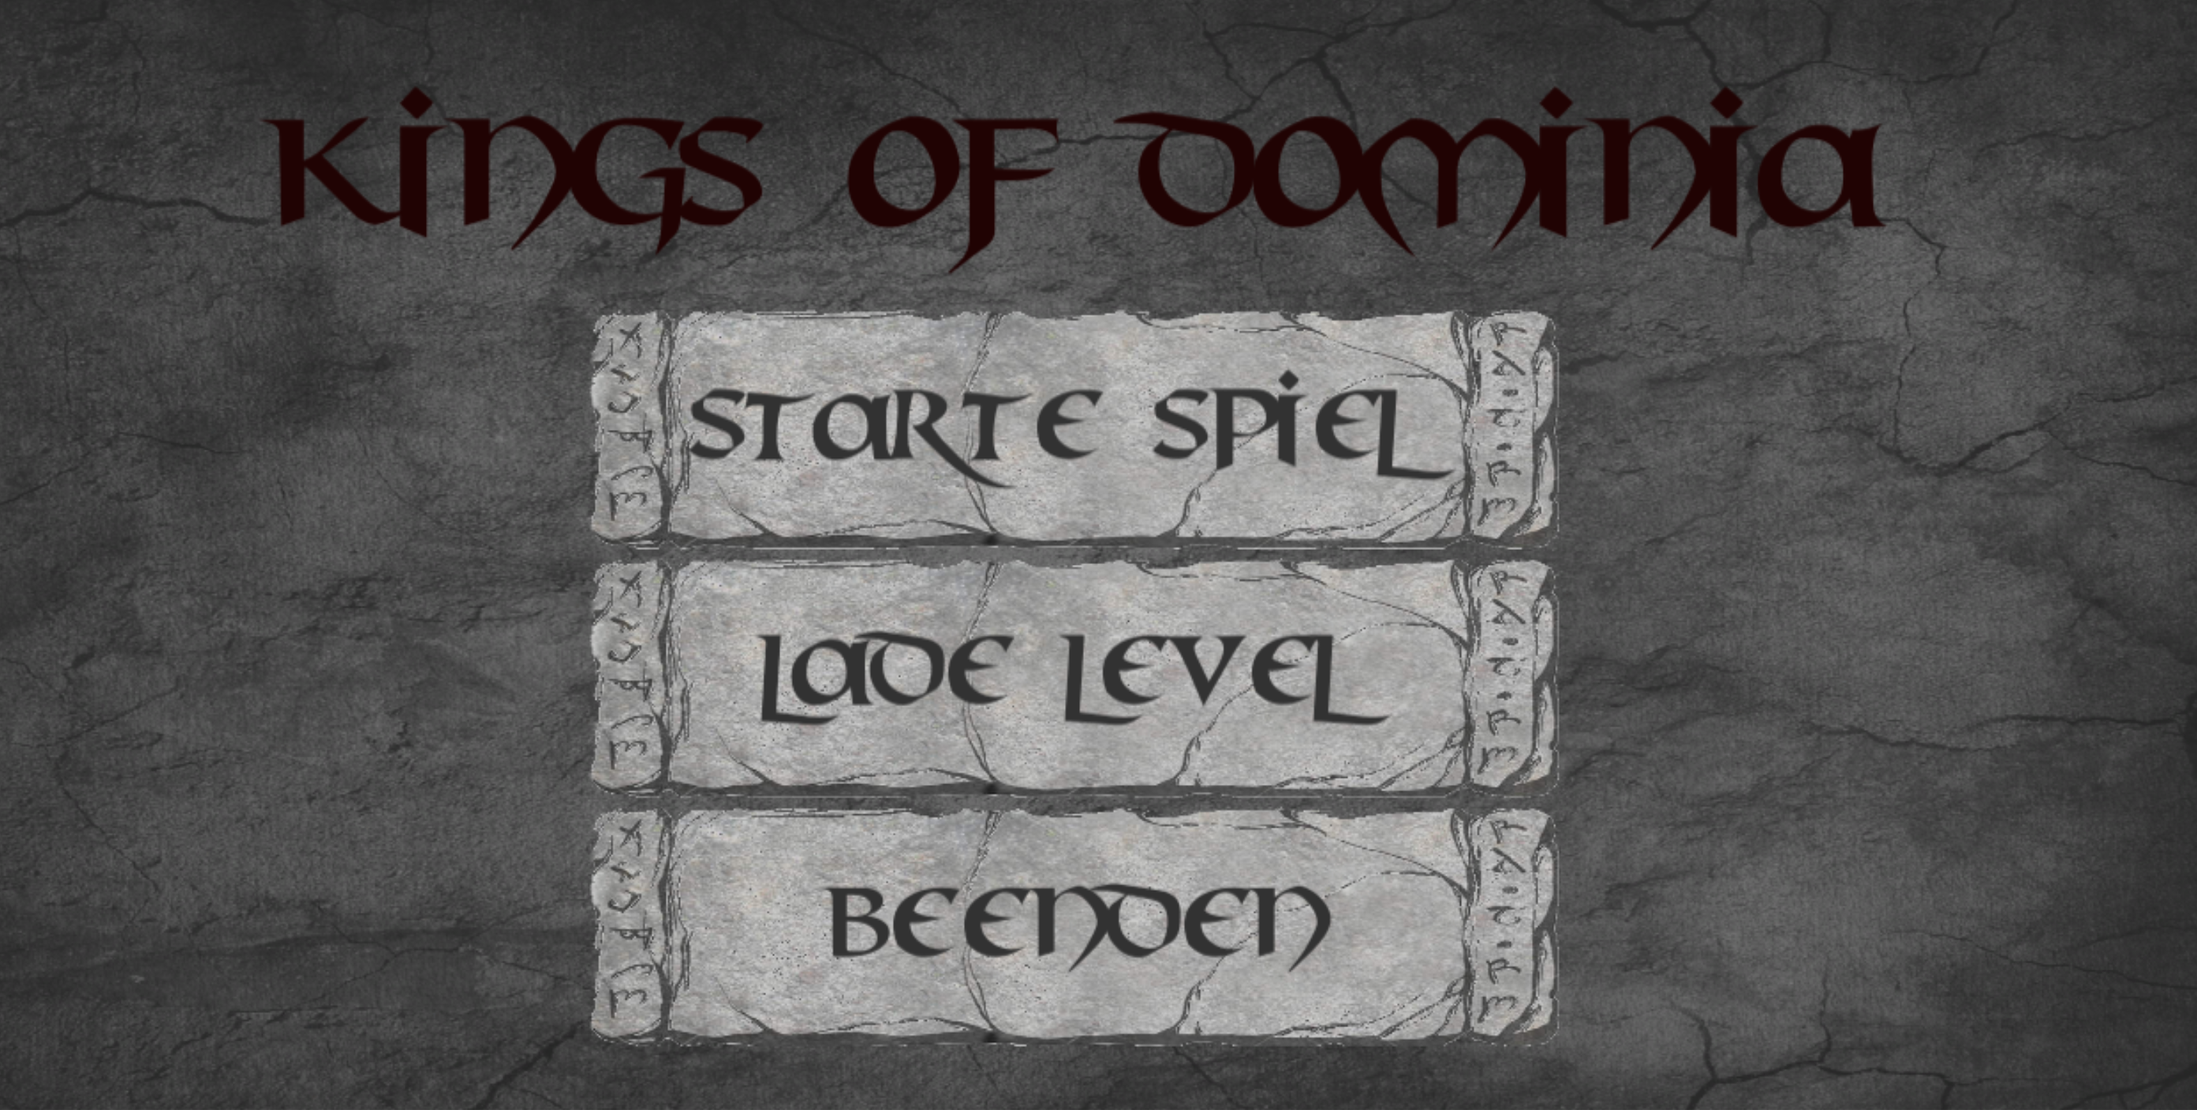
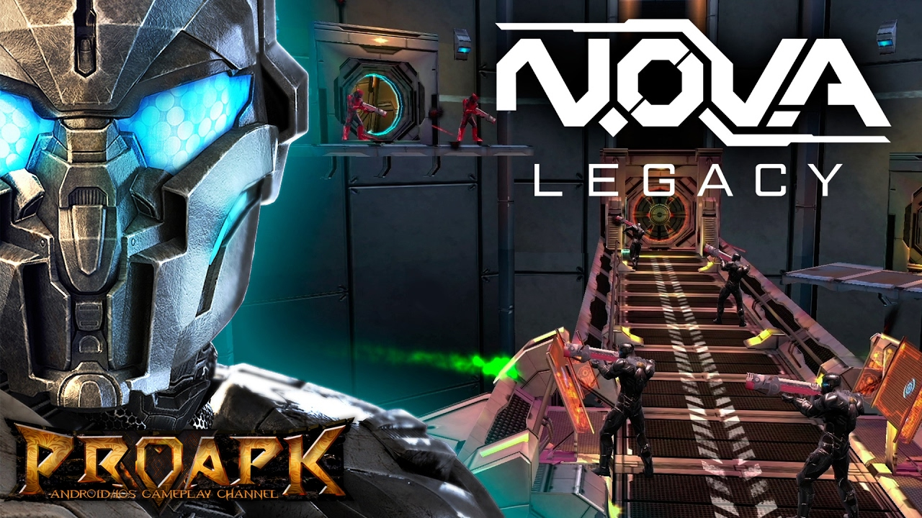
Costs
0,79$
2,99$
4,99-6,99$
[8]
[9]
Problem: many games are free to play

Slide 31
Break-Even
- Fixed costs
dollars
- Fixed costs (+20%)
units sold
-30% platform fee

Slide 32
Marketing Budget/Costs
Strengths + Weaknesses
extendability
high unit numbers to break-even
weak competition (genre)
target group hard to reach
graphics
High marketing efforts to generate enough reach
Strategy:
Universal app campaign
Youtube advertisment
High daily rates upon release

Slide 33
Thank you for your attention!
Any questions?

Slide 34
[1] http://blastside.com/2017/04/20/programmer-problems/
[2] https://twitter.com/asapscience/status/638018407913250817
[3] https://www.freepik.com/blog/the-75-funniest-design-jokes-only-designers-relate-to/
[4] http://www.geeksisters.de/gamer-girls-und-wie-sie-die-welt-sieht/
[5] https://hemator.wordpress.com/tag/batman-the-animated-series/
[6] https://www.teamgeist.com/en/domino-event-for-large-groups-bremen/
[7] https://www.statista.com/statistics/268251/number-of-apps-in-the-itunes-app-store-since-2008/
[8] http://www.spielaffe.de/Spiel/Doodle-Jump
[9]

